Slide 1
ACHILLES for i2b2
Information Technologies & Services
Research Informatics
ETL Working Group - August

Slide 2
ACHILLES Heel
Automated Characterization of Health Information at Large-scale Longitudinal Evidence Systems
a platform which enables the characterization, quality assessment and visualization of observational health databases
provides users with an interactive, exploratory framework to assess patient demographics, the prevalence of conditions, drugs and procedures, and to evaluate the distribution of values for clinical observations
Two components: R package and visualizations
  We just emulate the R package

Slide 3
ACHILLES HEEL R Package
R package generates summary statistics which describe the quality and content of the patient-level observational health database and provides features to perform a simple review or bulk export of the summary statistics.
Emulate this for i2b2 using T-SQL.
  CHALLENGE: Many of these checks are specific to OMOP Common Data Model
  Can we create similar i2b2-specific checks?

Slide 4
ACHILLES for i2b2
Creates 4 tables in i2b2demodata
  ETL_RESULTS
  ETL_FACT_DENSITY_ANALYSIS
  ETL_PROV_DENSITY_ANALYSIS
  ETL_PATIENT_COMPLETENESS_ANALYSIS

Slide 5
ETL Results
Notes:
Marcos

Slide 6
Understanding PAT_IDs
  Not every PAT_ID in Epic has an MRN
    Roughly 370k patients that do not have an MRN with an IDENTITY_TYPE_ID of 3
    POIS uses IDENTITY_TYPE_ID of 2 in those cases
    This leads to more questions:
          Where are Type 2 identifiers used?
          Is there potential for conflict when using this identifier?
          Should we map these patients with these identifiers?
Notes:
Julian
Marcos

Slide 7
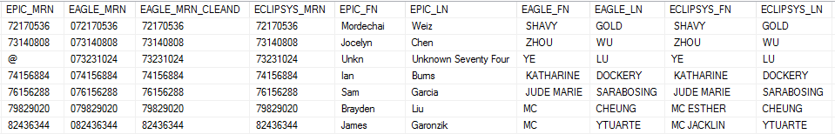
Understanding MRNs
  We already know that some patients share MRNs across systems that should not.
    MRN_MISMATCH table
    Do these mismatches cause issues when trying to rectify encounters?
  MRN not granular enough to be good criteria for linking patient encounters together.
    Neither is PAT_ID
    Or PAT_ID + MRN together
    What do?
Notes:
Bo

Slide 8
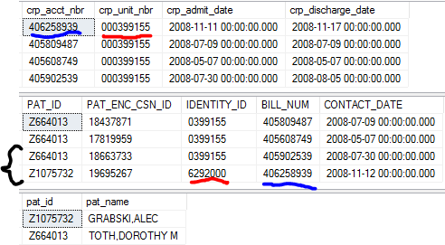
Understanding Account Numbers and Encounters
Logically, if an encounter matches between two systems, the encounter should be for the same person, right?
  Should cover cases of disjoint MRN use
  But what if two systems use the same range for its encounter identifier, but the MRN associated for these encounters in both systems link to different people?
Ormanager
Epic
Epic
Notes:
Jacob
Julian

Slide 9
Understanding Account Numbers and Encounters
BILL_NUM
  Holds the invoice number for that particular Epic encounter
  No standard representation of values
  No standard granularity of values
  No table or column to determine the representation or granularity of values.
  As far as we can tell, values in that system can come from Epic itself, Allscripts SCM, Eagle Billing, and still other unknown systems.
  How do we know when our match is correct without needing patient identities?
Notes:
Jacob
Julian

Slide 10
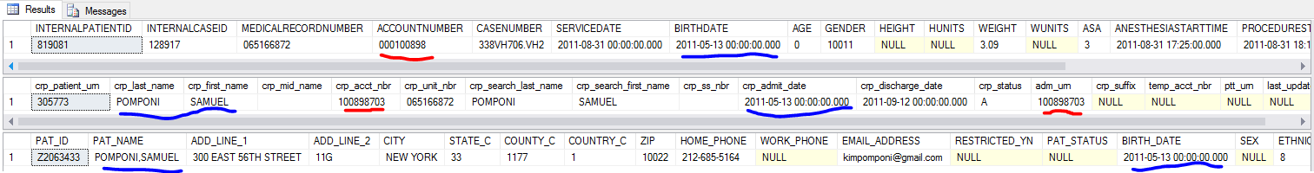
Understanding Account Numbers and Encounters
Cannot assume that data is replicated cleanly through the interfaces
  Two examples:
    1. CompuRecord and mangled account numbers
    “First Zero Significance”
    2. Not all systems have all the MRNs
Notes:
Jacob
Julian

Slide 11


Understanding Account Numbers and Encounters
User error causes nothing but headaches
  Stochastic error that cannot be accounted for logically
  I try to detect and ignore it
PAT_ID|NYP_MRN|JUPITER_MRN
PAT_ID|PAT_NAME
Notes:
Jacob
Julian

Slide 12
Understanding Account Numbers and Encounters
  Something curious happens when you try to match account numbers to Epic encounters via BILL_NUM…
  Conceptually, what is a patient’s account number in respect to their PAT_ENC_CSN_ID, and how are they related?
    A patient’s account number is for one inpatient visit
    A patient’s PAT_ENC_CSN_ID is for one outpatient visit
    Definitions for these types of visits are not the same
    When the interface sends inpatient information to Epic, that one account number gets multiple PAT_ENC_CSN_IDs
    There’s no way to tell these are the same encounter without BILL_NUM
Notes:
Tom

Slide 13
You Know Nothing, Jon Snow
Let’s recap what we know for certain at this point:
  A patient can have multiple MRNs or none at all.
  A patient can have more than one PAT_ID.
  Patients can share MRNs when they should not.
  Encounter identifiers from different systems can have overlapping ranges.
  Encounters identifiers can be wrong and result in missed or erroneous matches.
  Multiple PAT_ENC_CSN_ID values can match one account number and refer to the same encounter.
  BILL_NUM hold values that may look like an account number, but may not be an account number.
  You need access to multiple systems to diagnose certain types of inconsistencies in one.
Sounds like we need a unique identifier for patients and encounters that doesn’t exist.
Notes:
Tom

Slide 14
EMPI?
Columbia used it, reported more accuracy
Better, but not perfect
  Some patients that share encounters and are the “same” patient are distinct at the EMPI level
  Not every patient has an EMPI entry
  Some patients have more than one EMPI entry
  Doesn’t fix everything
  It does help with figuring out who shares MRNs but are different people

Slide 15
What do we know?
  We know we have to make one of each for i2b2.
    The most robust and least prescriptive method for linking together patient identities exists at the encounter level.
    If an encounter happens “on the same day” across two systems, then it belongs to the same person no matter what the MRN is…usually.
    Instead of patient mapping informing encounter mapping, encounter mapping actually informs patient mapping!
Notes:
Tom

Slide 16
Bootstrapping
Start with a data set that is internally valid.
  Outcome: One i2b2 patient number for a tuple of <PAT_ID, MRN>
  Easy to verify with SQL
  “Truth set”
Graft on the exceptions in a later step.
Notes:
Tom

Slide 17
Pass 1: Establishing a basis of truth
Start with just Epic data
Map Allscripts data to Epic data where the account numbers, MRNS, EMPI, and dates match exactly
Map Eagle billing data to the data set where the account numbers, dates, and MRNs match exactly from either Allscripts or Epic
  MRN matching tries to account for leading zeroes
  No EMPI for eagle billing…yet.
No “new” data
Small amounts of user error and data duplication still present.

Slide 18
Pass 1: Refining the basis of truth
Find the edge cases where one patient has more than one i2b2 number.
  Sometimes has more than one EMPI_ID
  Give them the smaller of the two i2b2 patient numbers
Find the cases where two patients share an encounter but are distinct at the EMPI level
  Blank these encounters out from the Jupiter side
Still some error present, very small percentage of the table
  Drop these when mapping to IM_MPI_MAPPING

Slide 19
Pass 2: Adding hospital specific encounters
Not every encounter in Allscripts and Eagle comes into Epic
  Most MRNs exist, encounters do not
  “New” data
Bring these into the table from Allscripts as new rows where the account number does not exist in BILL_NUM
  If it does exist in BILL_NUM and is unmapped, it’s for a good reason
  Strict matching criteria
  Have to remap ORManager and CompuRecord as well
  Have to assign new i2b2 patient numbers for some patients
  No “new” Eagle data because no EMPI makes it hard.

Slide 20
Pass 2: Making encounter numbers
Start with inpatient side, end with outpatient side
  One account number gets one i2b2 encounter number
    Bundling
  One pat_enc_csn_id with no matching account number gets one i2b2 encounter number

Slide 21
Pass 2: Defining encounter types
The concept of inpatient / outpatient differs when you look at each system individually
Start with account numbers, end with PAT_ENC_CSN_ID
Eagle > Eclipsys > Epic
  Every encounter is treated as outpatient until we can determine that it is inpatient
  I don’t really trust epic’s definition of inpatient vs outpatient

Slide 22
Comments

Slide 23
Paver, Python, and ETLs
Information Technologies & Services
Research Informatics
ETL Working Group - August

Slide 24
Overview
Process
Step 1: Prepare directory
Step 2: Install Paver
Step 3: Prepare constants file
Step 4: Prepare db_utils.py file
Step 5: Prepare pavement.py file
Step 6: Prepare secondary files
Step 7: Prepare ETL task
Step 8: Explore possibilities

Slide 25
Assumptions
Python is installed
  Version doesn’t matter.
  Build doesn’t matter
  ODBC library to connect to your servers is installed
Command line installation is available
  Windows: pip/easy_install
  Linux: apt-get

Slide 26
Step 1:
Prepare directory

Slide 27
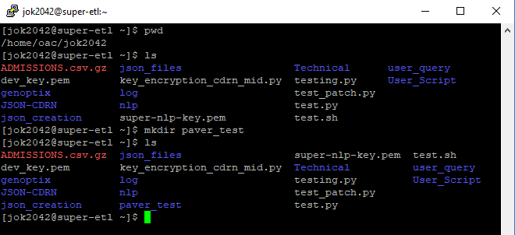
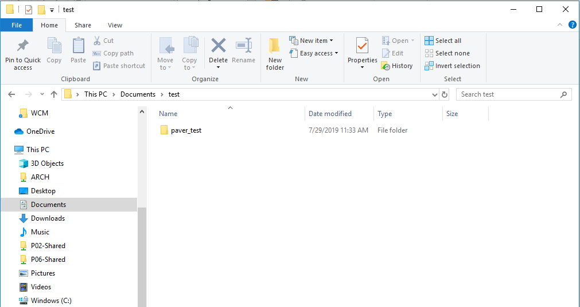
Create a directory to store your process
Linux
Create a directory to store your files/folders
Windows
Create a directory to store your files/folders
Create a directory to store your logs within the previously created directory

Slide 28
Step 2:
Install Paver

Slide 29
Install paver library
Windows
pip install paver
easy_install paver
Linux
sudo apt-get install python-paver
Not sure if yum will work as well

Slide 30
Step 3:
Prepare constants file

Slide 31
Constants file
Can be .py file or any other file that you can preload into python
If using .py file, call it constants.py
Format should be:
db_username = ''
db_password = ''
db_name = ''
server_addr = ''
program_name = '' #Name that will be the header of your log file
webhooks_address = ''
sql_file_directory = '‘ #Place where SQL scripts can be pulled from

Slide 32
Step 4:
Prepare db_utils.py file

Slide 33
db_utils.py file
Please see attached db_utils file.
Make changes within as per the next slide

Slide 34
db_utils.py file (Continued)
Changes:
Lines 35-38: Modify to odbc library that you use (pyodbc,pymssql)
Webhooks function notifies Slack, Teams, and other messaging clients – you can use your own configurations
Line 75: prefix argument is used to change within the SQL scripts the phrase “<prefix>” to whatever the prefix phrase is, which allows us to control contexts
sql_cmd_before and sql_cmd_after allows us to collect metrics on how much the tables grew or shrunk and others data points
ARCH.dbo.SUPER_LOG collects data on the scripts run – change to your own place to collect data within your server
Line 213: Modify to collect errors you want to handle

Slide 35
Step 5:
Prepare pavement.py file

Slide 36
pavement.py file
Please see attached pavement file.
To modify and expand this, you need to understand:
The @task decorator ensures that it is a usable task in paver
The @needs decorator references functions throughout the python files
The @run_scripts decorator executes the scripts referenced
  The first argument needed in the prefix, and then you can list as many scripts as you want
The @no_help decorator suppresses the task from being shown in the help.

Slide 37
Step 6:
Prepare secondary files

Slide 38
Secondary files
Please see attached secondary files:
test.py
test.sql

Slide 39
Step 7:
Prepare ETL task

Slide 40
ETL Task
Using the knowledge from before, update the pavement file with new tasks.

Slide 41
Step 8:
Explore possibilities

Slide 42
Example Task

Slide 43
Questions and Comments?

Slide 44
See readme.md for more info

