Slide 1
Loading genomic vcf files into i2b2
Janice Donahoe
Nich Wattanasin
Partners HealthCare Systems

Slide 2
Community Project Overview
This community project extends the current i2b2 query functionality by providing the ability to query for genotyped subjects by specific annotations related to genetic variants
Our package provides a starting point and working example of our local implementation:
  Source code for ETL process of VCF files
  Example data representation & SQL scripts
  Example i2b2 ontology & metadata XML
  Web Client widgets to submit queries

Slide 3
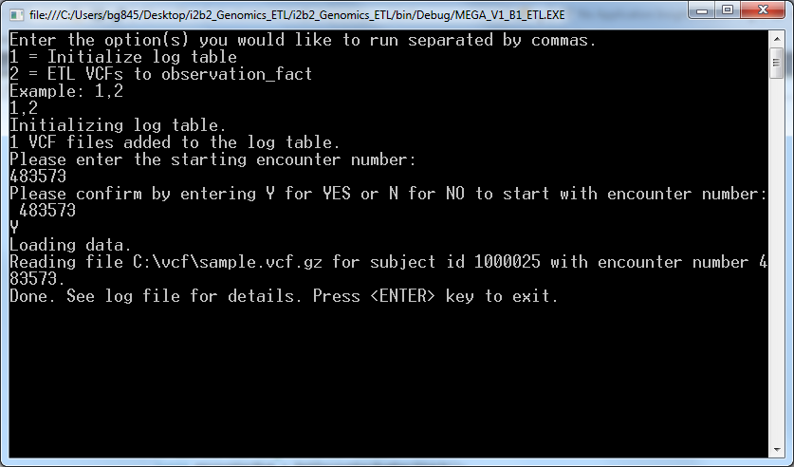
ETL Process
Variant Call Format (VCF) is a text file format to store genetic variations and contains information about positions in the genome
We created a .NET program
that extracts, transforms, and
loads VCF files into i2b2

Slide 4
Data Representation
New facts are created for the patient and the variant data is stored in the observation_blob field
<RSID | “missing_rsid”>,<REF_TO_ALT>,<GENE_SYMBOL | “missing_gene”>,<ZYGOSITY | “missing_zygosity”>,<CONSEQUENCE | “missing_consequence”>
Example:
CONCEPT_CD | INSTANCE_NUM | VALTYPE_CD | OBSERVATION_BLOB
SO:0001483 | 1 | B | rs377573539,T_to_C,MIR6723,homozygous_ref_ref,upstream
SO:0001483 | 2 | B | rs6429759,C_to_T,AGMAT,homozygous_alt_alt,intron
SO:0001483 | 3 | B | rs2298948,T_to_C,GCFC2,heterozygous_ref_alt,intron
SO:0001483 | 4 | B | rs12640778,C_to_T,LINC01060,heterozygous_ref_alt,intron
SO:0001483 | 5 | B | rs1060583,G_to_A,NECAB1,heterozygous_ref_alt,3'UTR

Slide 5
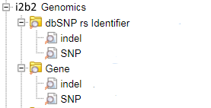
Ontology Representation
We created the following tree representation to
allow the researcher to search by rs identifier or
gene name
We populated value_metadata_xml for each
concept, enabling a custom value chooser dialog to pop-up when the concept is dragged into the query tool
<?xml version="1.0"?>
<ValueMetadata>
<Version>3.03</Version>
<CreationDateTime>01/28/2016</CreationDateTime>
<TestID>SO:0001483</TestID>
<TestName>SNP</TestName>
<DataType>GENETIC_VARIANT_SNP</DataType>
<Oktousevalues />
<MaxStringLength>30</MaxStringLength>
<EnumValues />
<UnitValues>
<NormalUnits/>
</UnitValues>
</ValueMetadata>

Slide 6
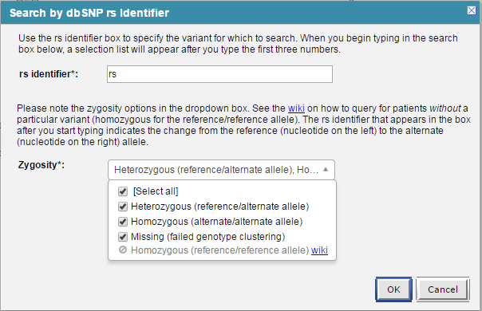
Querying in Web Client
A custom value box is shown
when dragging over a new
genomic concept into the i2b2
query tool

Slide 7
Querying in Web Client
The query utilizes the value_operator CONTAINS and value_type LARGE TEXT to convert the request XML to a proper SQL contains statement:
with t as (
select f.patient_num
from dbo.observation_fact f
where
f.concept_cd IN
    (
      select concept_cd
      from dbo.concept_dimension
      where concept_cd IN ('SO:0001483','SO:1000032')
    )
    AND (modifier_cd = '@' AND valtype_cd = 'B'
    AND CONTAINS(observation_blob,'rs377573539 AND T_to_C AND (Heterozygous OR Homozygous OR missing_zygosity)')
)
...

Slide 8
Acknowledgements
Biobank Portal Team
Bhaswati Ghosh
Alyssa Goodson
Nich Wattanasin
Victor Castro
Andrew Cagan
Reeta Metta
Jay Tarantino
David Wang
Barbara Benoit
Heekyong Park
Vivian Gainer
Shawn Murphy
I2b2 Team
Lori Phillips
Mike Mendis
Janice Donahoe
Nich Wattanasin
Shawn Murphy
Diane Keogh

