Slide 1
Development of Genomics Plugins in i2b2
Lori Phillips, MS
AUG Meeting
June 18, 2013

Slide 2

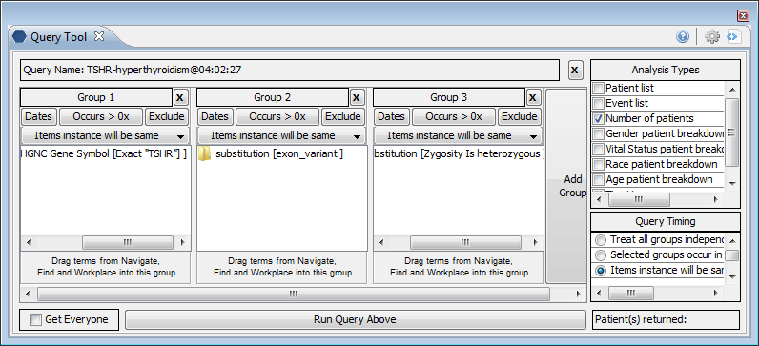
Big Picture - Data flow of next-gen sequencing
base calls from the sequencer
FASTQ files with base calls
SAM with standard alignment
VCF digests variants
GVF maps to ontologies
De-identified Data Warehouse

Slide 3
Importing NGS variant output into i2b2
VCF
ANNOVAR
GVF
i2b2
Variant Call Format
Gene Annotated VCF
Genome Variation Format
Observation
fact

Slide 4
Pipeline - VCF to VCF-ANNO
1 1105366 . T C . PASS AA=T;AC=4;AN=114;DP=3251 GT:DP 1/0:54
VCF
ANNOVAR*
exonic TTLL10 1 1105366 1105366 T C 1 1105366 . T C . PASS AA=T;AC=4;AN=114;DP=3251 GT:DP 1/0:54
VCF-ANNO
*Wang K, Li M, Hakonarson H. ANNOVAR: Functional annotation of genetic variants from next-generation
sequencing data Nucleic Acids Research, 38:e164, 2010 (www.openbioinformatics.org/annovar)

Slide 5

Pipeline - VCF-ANNO to GVF
exonic TTLL10 1 1105366 1105366 T C 1 1105366 . T C . PASS AA=T;AC=4;AN=114;DP=3251 GT:DP 1/0:54
VCF-ANNO
2GVF*
GVF
chr1 VCF SNV 1105366 1105366 . +
. ID=1;Reference_seq=T;Variant_seq=C;Variant_feature=exonic;Gene=TTLL10;
Genotype=heterozygous
*Kong, Sek-Won, Lee, Joon, Boston Children’s Hospital (perl script) modified for ANNOVAR by Lori Phillips

Slide 6
Pipeline – GVF to I2B2 records
chr1 VCF SNV 1105366 1105366 . +
. ID=1;Reference_seq=T;Variant_seq=C;Variant_feature=exonic;Gene=TTLL10;
Genotype=heterozygous
GVF
GVF2I2B2
1880001024|1000000024|"SO:0001483"|"@"|"2010-03-03 00:00:00"|"@"|1||||||||||||||"GVF2I2B2"|
1880001024|1000000024|"SO:0001483"|"@"|"2010-03-03 00:00:00"|"SO:0000340"|1|"T"| "chr1"||||||||||||"GVF2I2B2| (chr1)
1880001024|1000000024|"SO:0001483"|"@"|"2010-03-03 00:00:00"|"SEQ:Start"|1|"N"|"E“| 1105366|||||||||||"GVF2I2B2| (start position)
1880001024|1000000024|"SO:0001483"|"@"|"2010-03-03 00:00:00"|"SEQ:End"|1|"N"|"E"| 1105366|||||||||||"GVF2I2B2| (end position)
1880001024|1000000024|"SO:0001483"|"@"|"2010-03-03 00:00:00"|"SO:0001029"|1|"T"| "+"||||||||||||"GVF2I2B2”| (+ strand)
1880001024|1000000024|"SO:0001483"|"@"|"2010-03-03 00:00:00"|"SEQ:Zygosity"|1|"T"| "heterozygous"||||||||||||"GVF2I2B2”| (heterozygous)
1880001024|1000000024|"SO:0001483"|"@"|"2010-03-03 00:00:00"|"SEQ:HUGO"|1|"T"| "TTLL10"||||||||||||"GVF2I2B2"| (associated gene)
1880001024|1000000024|"SO:0001483"|"@"|"2010-03-03 00:00:00"|"SO:0001791"|1|| ||||||||||||"GVF2I2B2"| (exonic variant)
I
2
B
2

Slide 7
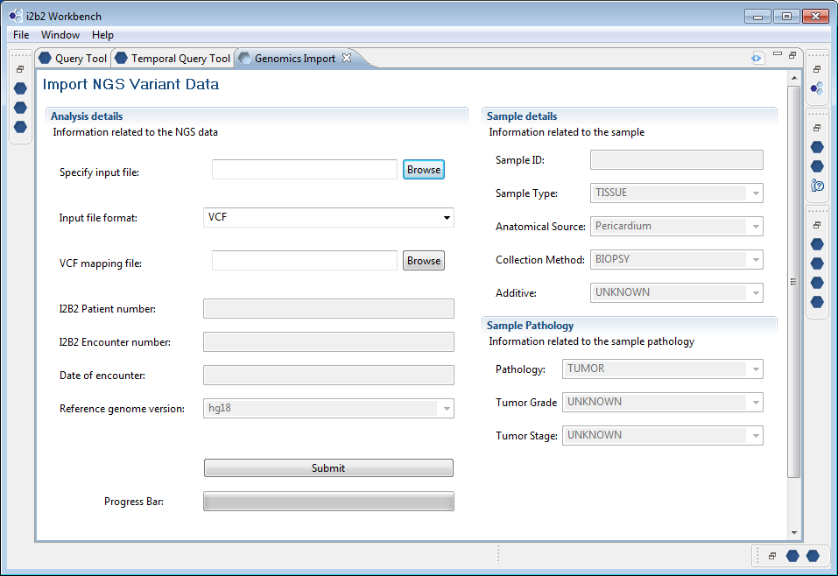

Slide 8
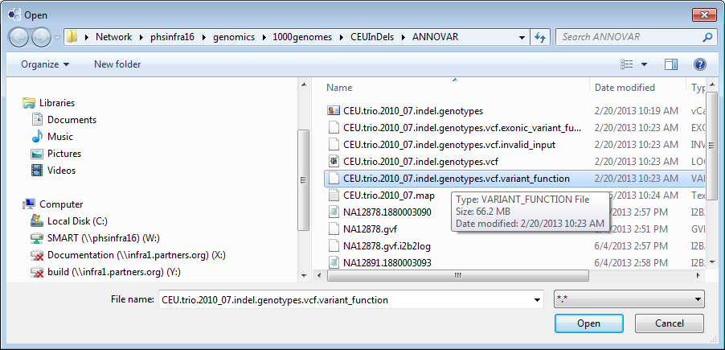

Slide 9
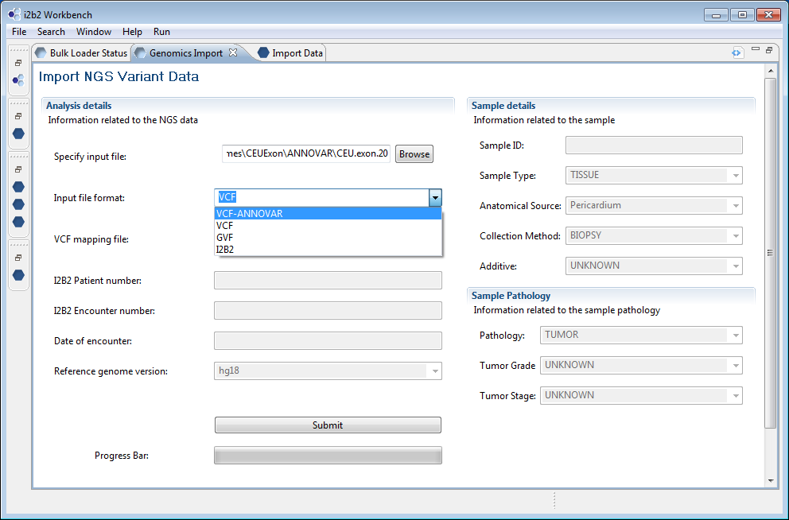
Genomics Import Plugin

Slide 10
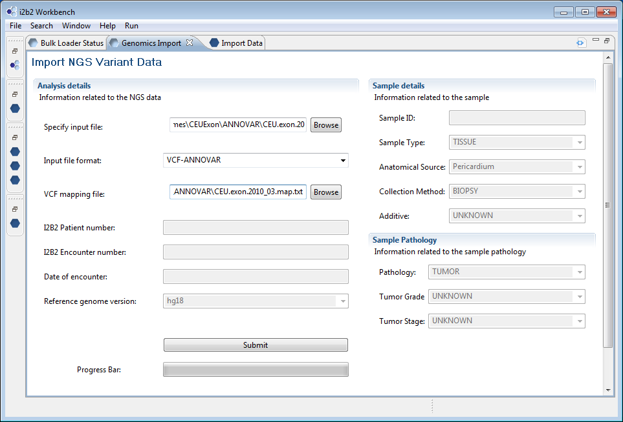

Slide 11
Mapping file
##genome-build hg18
##file-date 2010-07-07
#sample|patient_num|encounter_num
NA12878|1000000090|1880003090
NA12891|1000000093|1880003093
NA12892|1000000094|1880003094

Slide 12
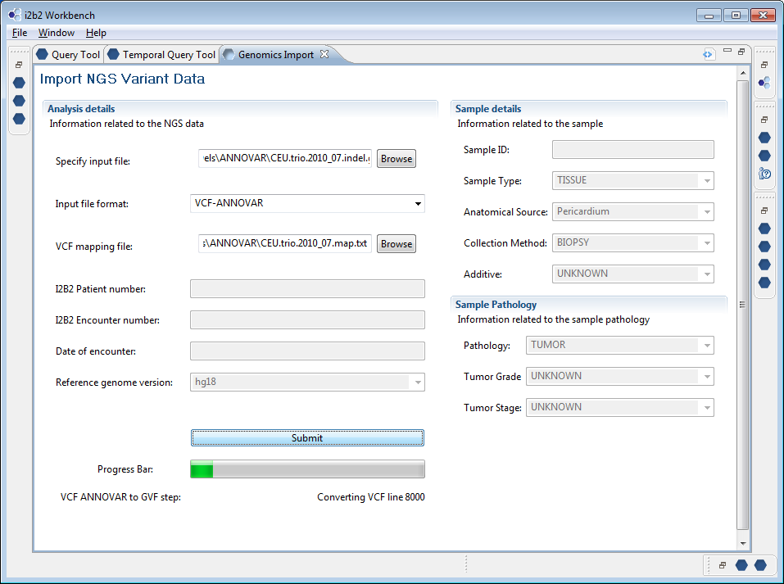

Slide 13
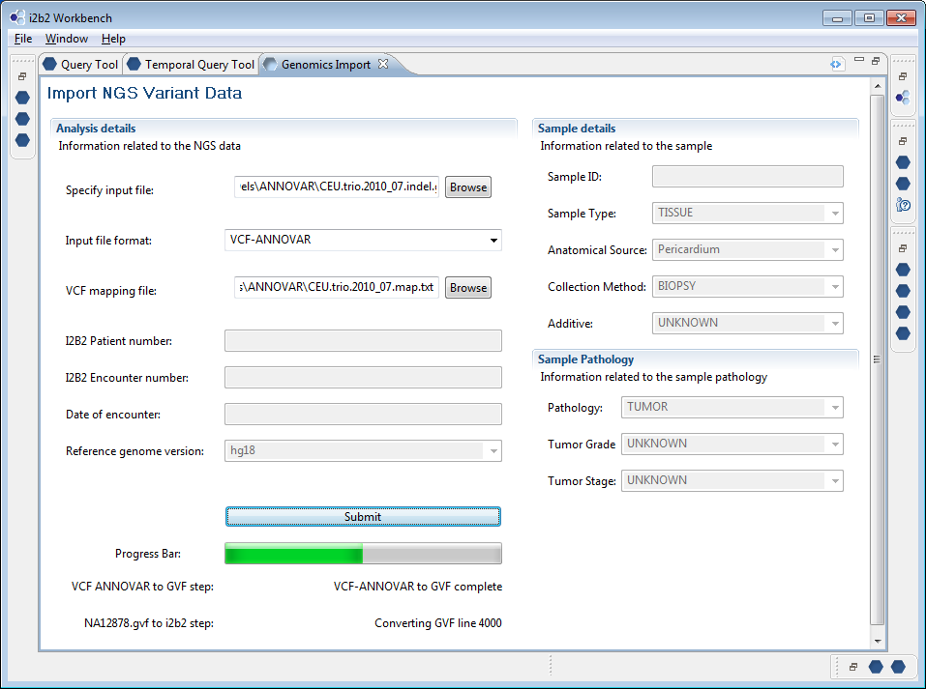

Slide 14
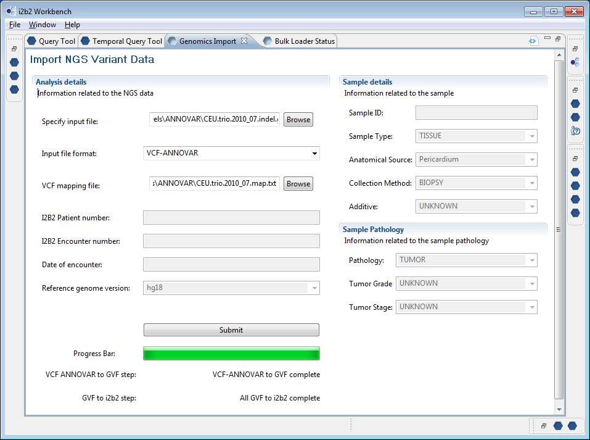

Slide 15
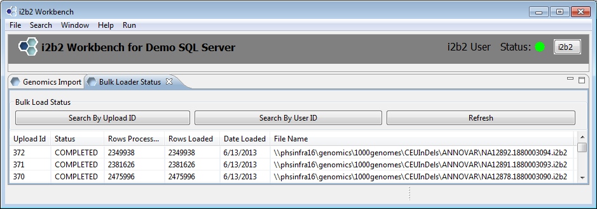
Bulk Loader Status

Slide 16

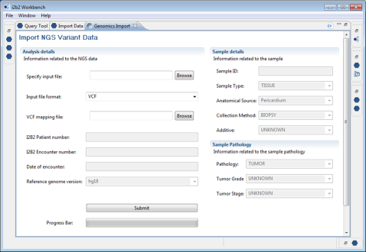
Bulk Loading Observations
2. Tell the CRC
the file is ready
to load
2
CRC
3. SSIS package
loads the i2b2 file to
observation_fact table
SSIS
3
I2B2
FR
1
1. Send the i2b2 file to the FR

Slide 17
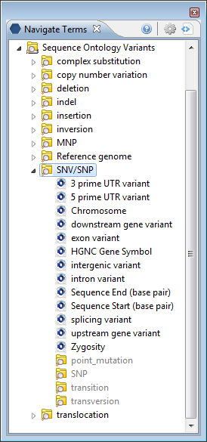
Navigating NGS Variant Data with Sequence Ontology
An SNV/SNP located on a 3’UTR
An SNV/SNP associated with a certain gene
An SNV/SNP of specified zygosity
Combination of concepts and modifiers to identify:

Slide 18
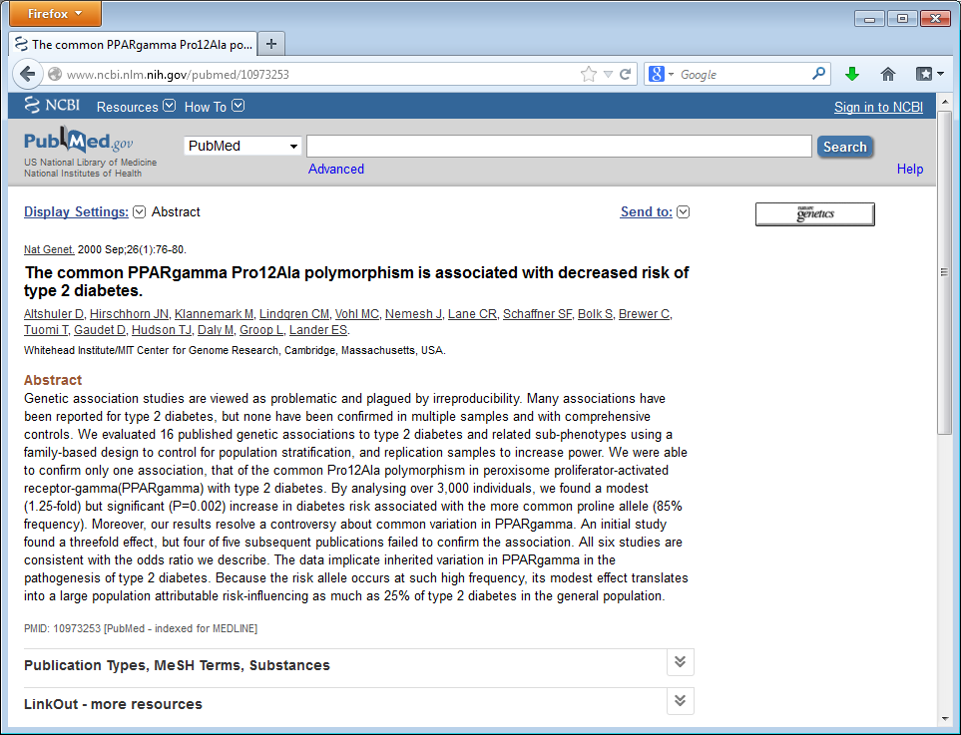

Slide 19


Slide 20
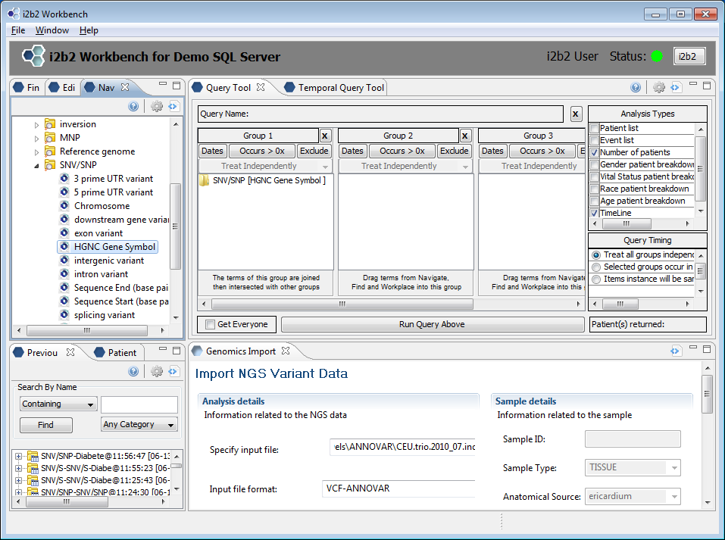
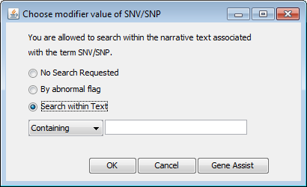
Gene Association Modifier

Slide 21
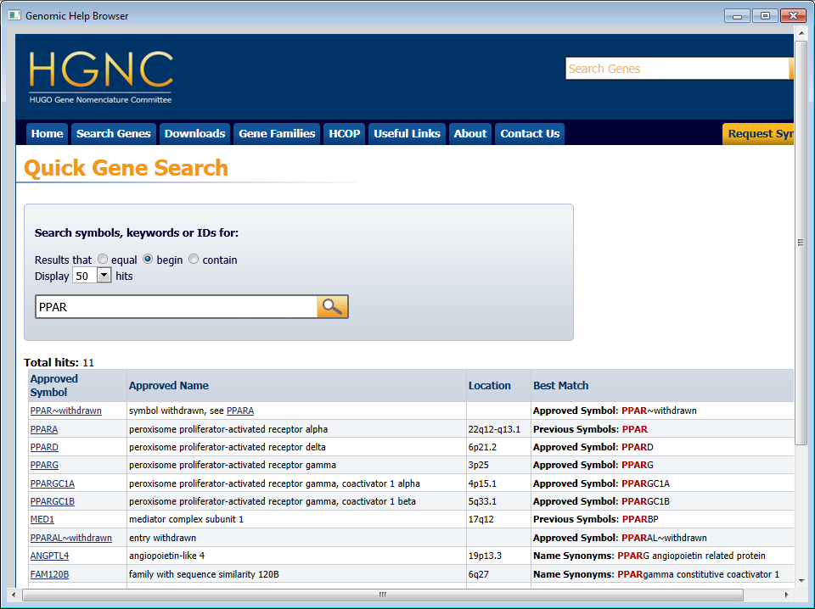

Slide 22
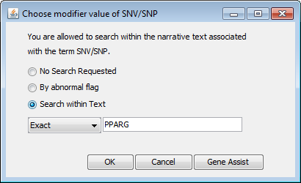
Specifying Gene Association Modifier

Slide 23
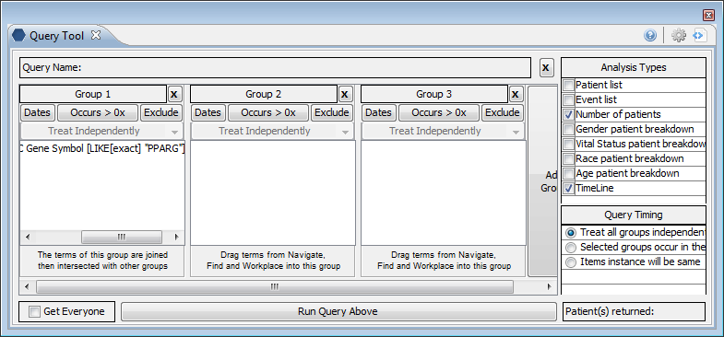
Building a Translational Genomic Query
Group1: SNV/SNP with HGNC Gene Symbol modifier of “PPARG”

Slide 25
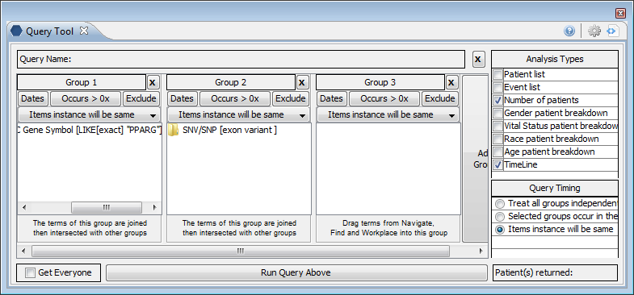
Building a Translational Genomic Query
Group 2: SNV/SNP with exon variant modifier
  Note that “Items instance will be same” is selected on the panels

Slide 26
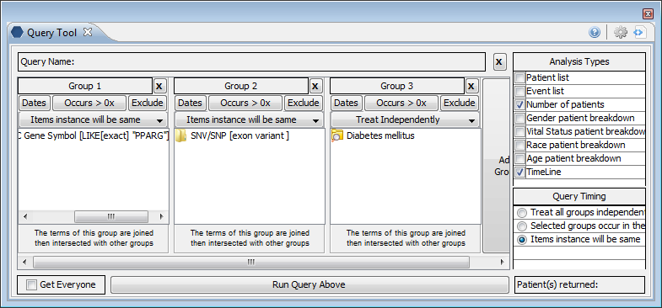
Building a Translational Genomic Query
Group 3: Diabetes Mellitus
  Select “Treat Independently” for this panel

Slide 27
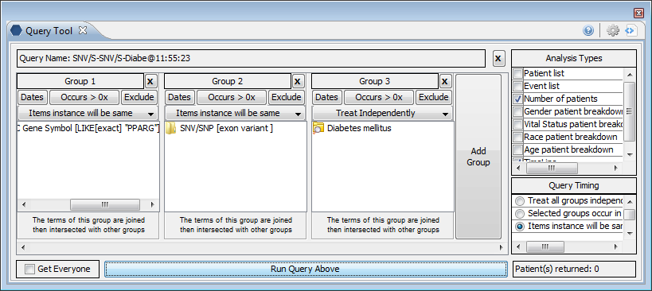
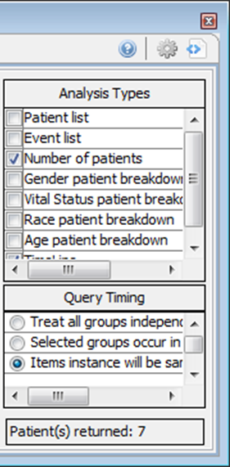
Run the query

Slide 28
Summary
A Genomics plug-in was created to create observation-fact files from VCF files.
A bulk loader was written in native (SQL Server) code to allow for the rapid loading of 2-5 million rows / patient into observation-fact table.
Sequence Ontology (available at NCBO) that is associated with GVF format can be used to query the next generation sequencing data that was imported into i2b2.

