Slide 1
Ontology Approaches for Federated Query Systems
Lori Phillips MS
March 2015

Slide 2

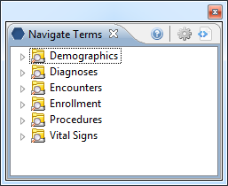
Use Case
A requirement in some federated query systems such as PCORI is that all i2b2 instances need to map their ontologies to a central ontology.
Local codes need to be integrated into the central hierarchy
Tools and strategies to assist with this effort

Slide 3
Constructing queries from metadata
select patient_num from observation_fact where [c_facttablecolumnname] IN
(select [c_facttablecolumnname] from [c_tablename] where [c_columnname] [c_operator] [c_dimcode])

Slide 4
i2b2 Star Schema
Notes:
4

Slide 5
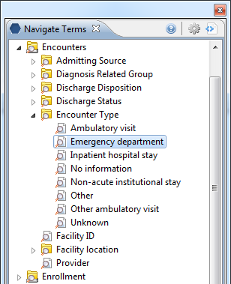
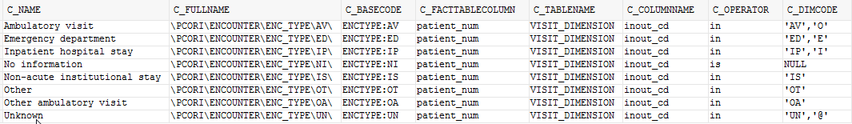
Visit_dimension types of queries:Encounter types
select patient_num from visit_dimension where inout_cd IN (‘ED’,‘E’)
Edit c_dimcode to match your inout_cds.

Slide 6
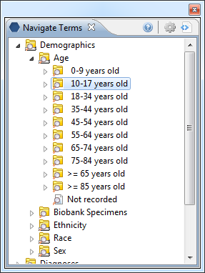
Patient_dimension types of queries:Age calculations
select patient_num from patient_dimension where birth_date BETWEEN
sysdate – (365.25*18) AND sysdate – (365.25*10)
No modifications necessary.

Slide 7
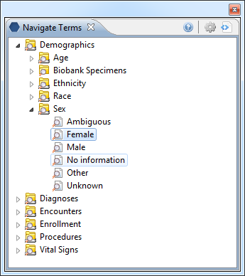
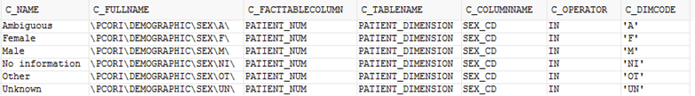
Patient_dimension types of queries:Sex
select patient_num from patient_dimension where sex_cd IN (‘F’)
Edit c_dimcode to match your sex_cds.

Slide 8
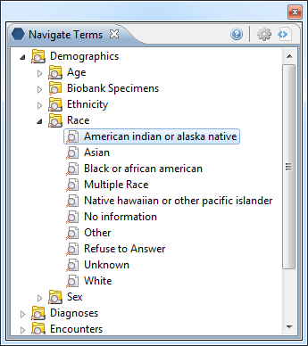
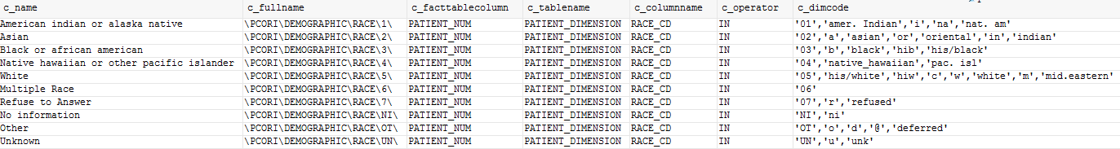
Patient_dimension types of queries:Race
select patient_num from patient_dimension where race_cd IN (‘01’,‘amer. Indian’,‘i’, ‘na’,‘nat. am’)
Edit c_dimcode to match your race_cds.

Slide 9
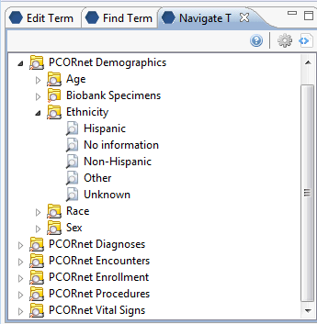
Patient_dimension types of queries:Ethnicity
select patient_num from patient_dimension where ethnicity_cd IN (‘HISPANIC’)
Create an ethnicity_cd column in patient_dimension
Edit c_dimcode to match your ethnicity_cds.

Slide 10
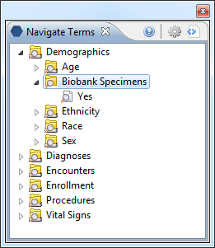
Concept_dimension types of queries:Biobank
select concept_cd from concept_dimension where concept_path like '\PCORI\DEMOGRAPHIC\BIOBANK_FLAG\Y\%'
Edit c_basecode to match your code for biobank specimens.

Slide 11
patient_dim v concept_dim approaches
HISTORY: early versions of i2b2 did not support the patient_dimension approach.
  Demographic data was inserted as entry in observation_fact table and as a result appeared as a tick mark on the timeline.
Patient_dimension approach does not require an entry in the observation_fact table for that concept.
Patient_dimension approach will not result in a tick mark in the timeline for that concept.
Patient_dimension approach is easier to maintain.

Slide 12
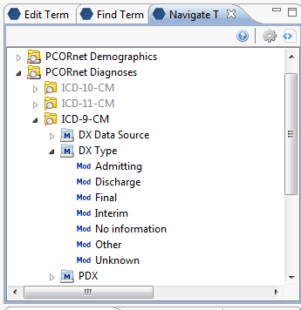
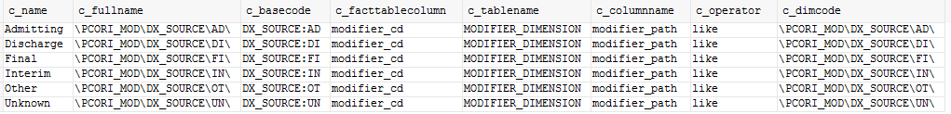
Modifiers
select modifier_cd from modifier_dimension where modifier_path like '\PCORI_MOD\DX_SOURCE\AD%'
Edit c_basecode to match your codes for DX Type

Slide 13
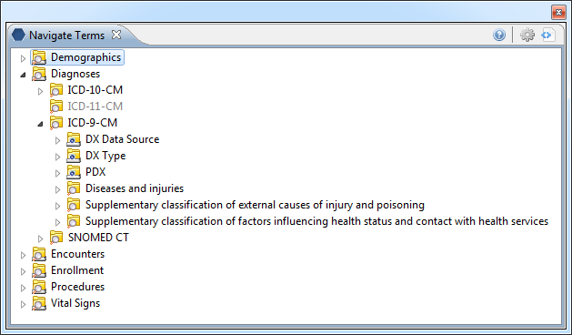
Broader concept_dimension based queries
Diagnoses, Procedures typically require a merge
of local terms within the tree.

Slide 14
ICD-9 Example
If your institution uses ICD-9 …
  Change the c_basecode to match your code format.
  PCORI_BASECODE C_BASECODE
  ICD9:250.1 MY_ICD9:250.1
  update pcornet
  set c_basecode = replace(pcori_basecode, ‘ICD9:’, ‘MY_ICD9:’)
  where c_basecode is not null
  and pcori_basecode like 'ICD9:%'
  and c_fullname like ‘\PCORI\DIAGNOSIS\09\%‘;

Slide 15
ICD-9 plain_code example
If your institution uses ICD-9 but in a plain_code format…
  Change the c_basecode to match your code format.
  PCORI_BASECODE C_BASECODE
  ICD9:250.1 2501
  update pcornet
  set c_basecode = substring(pcori_basecode, 6, 25)
  where pcori_basecode like 'ICD9:%'
  and c_fullname like ‘\PCORI\DIAGNOSIS\09\%‘;
  update pcornet
  set c_basecode = replace(c_basecode, '.', '')
  where pcori_basecode like 'ICD9:%'
  and c_fullname like ‘\PCORI\DIAGNOSIS\09\%‘;

Slide 16
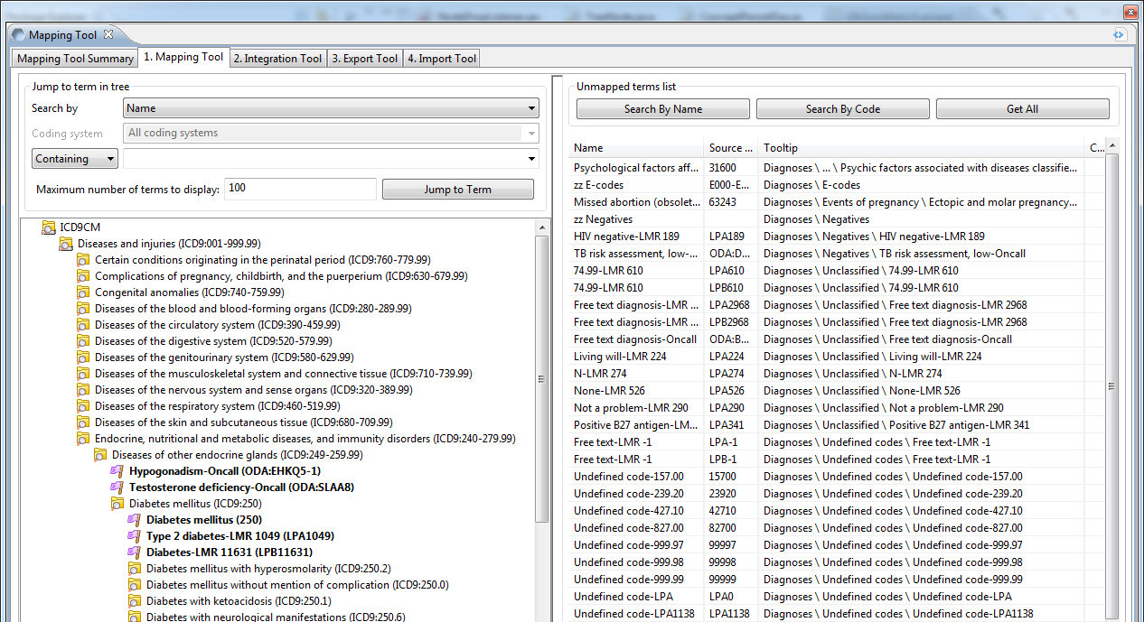
Local diagnoses codes (non-ICD9)
Local codes need to be mapped/merged.
Mapper cell / mapping tool plugins exist for workbench.

Slide 17
PROJECT_ONT_MAPPING
SOURCE_CODING_SYSTEM | VARCHAR(50)
SOURCE_BASECODE | VARCHAR(50)
SOURCE_NAME | VARCHAR(2000)
SOURCE_FULLNAME | VARCHAR(700)
SOURCE_TOOLTIP | VARCHAR(700)
SOURCE_TABLE_CD | VARCHAR(25)
SOURCE_KEY | VARCHAR(725)
DESTINATION_CODING_SYSTEM | VARCHAR(50)
DESTINATION_BASECODE | VARCHAR(50)
DESTINATION_NAME | VARCHAR(2000)
DESTINATION_FULLNAME | VARCHAR(700)
DESTINATION_TABLE_CD | VARCHAR(25)
DESTINATION_KEY | VARCHAR(725)
MAPPING_SOURCE | VARCHAR(50)
VARFLAG | VARCHAR(25)
FLAG | INT
STATUS_CD | VARCHAR(25)
UPDATE_DATE | DATETIME
C_TOTALNUM | INT
Source fields are local terms.
Destination fields are PCORI terms.

Slide 18
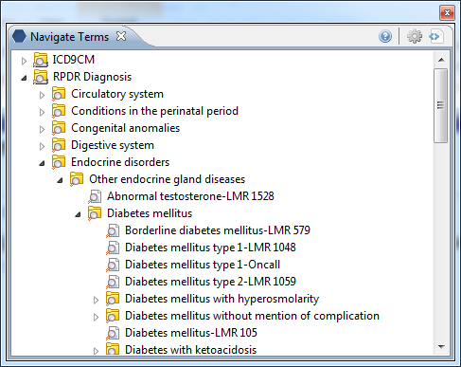
Reuse mappings from other projects
If your local codes already exist within an ICD9 hierarchy..
Find the c_fullname, c_basecode and c_name of parent of the term and use that as your mapping’s destination.

Slide 19
Reuse mappings, cont.
WITH joined as(
select r2.c_basecode as sourceCode, r1.c_fullname as destination, r1.c_basecode as destCode, r1.c_name as destName from local_ont r1 inner join local_ont r2 on r1.c_fullname=r2.c_path where r2.c_basecode in (select source_basecode from project_ont_mapping where destination_fullname is null))
update project_ont_mapping
set destination_fullname = joined.destination,
destination_basecode = joined.destCode,
destination_name = joined.destName
from joined
where joined.sourceCode = source_basecode

Slide 20
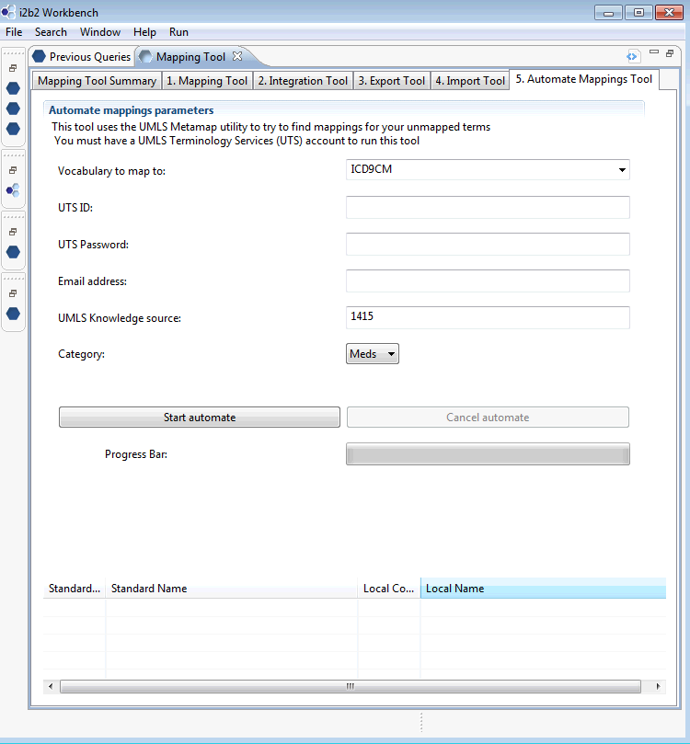
Automated mappings with UMLS MetaMap
Interactive tool that uses UMLS MetaMap to find mappings for your local unmapped terms.

Slide 21
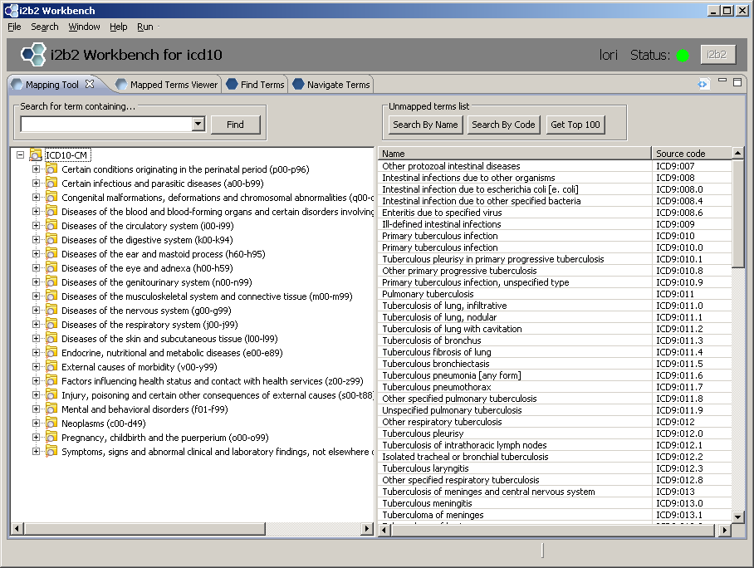
Manual mappings
Tool for assigning/verifying mappings

Slide 22
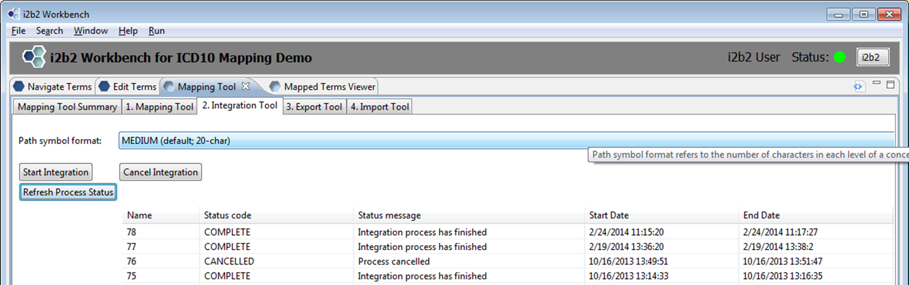
Integration tool
Tool to build ontology table after mappings are completed
Select path symbol format (S,M,L)
\i2b2\Diagnoses\Metabolic and immunity disorders (270-279)\
(277) Other and unspecified disor~\(277-0) Cystic fibrosis\
Start integration
Refresh process status until integration is complete.

Slide 23
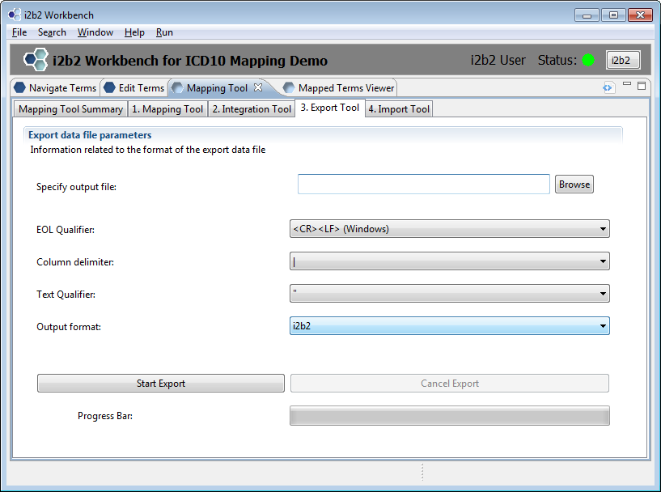
Export tool
Exports result of integration process as a single, delimited i2b2 metadata file.

Slide 24
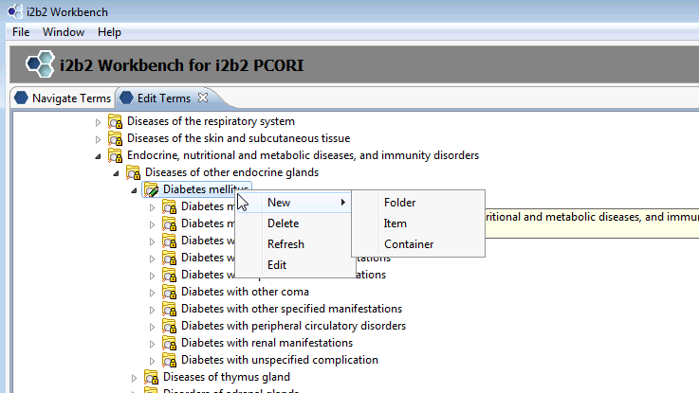
Alternate map/merge method
If you have small number of local codes to merge, use the Edit Terms view.
  User must be set up with EDITOR role

Slide 25
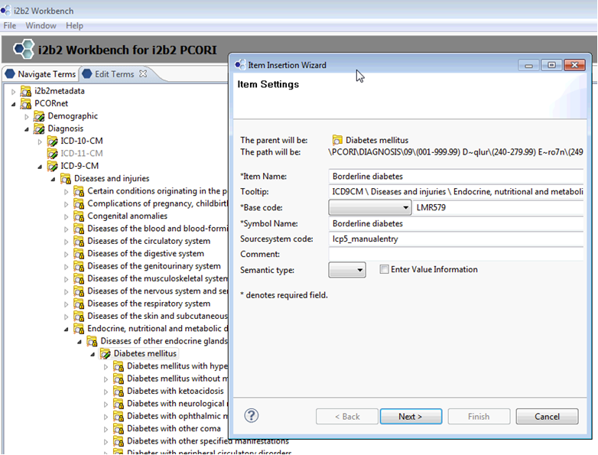
Edit Terms View

Slide 26
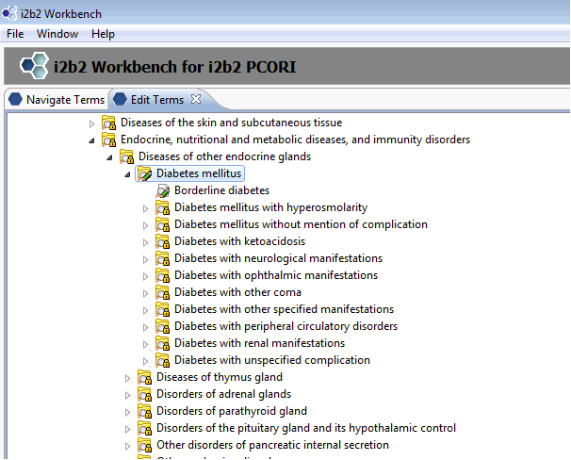
New term added
No need to export file, term is added to table automatically.

